Slide 1
ADAPTER DESIGN PATTERN
By
Muhammad Lukman Ismail Hanafi

Slide 2
Adapter is a structural design pattern that allows objects with incompatible interfaces to collaborate.
Source : refactoring.guru

Slide 4


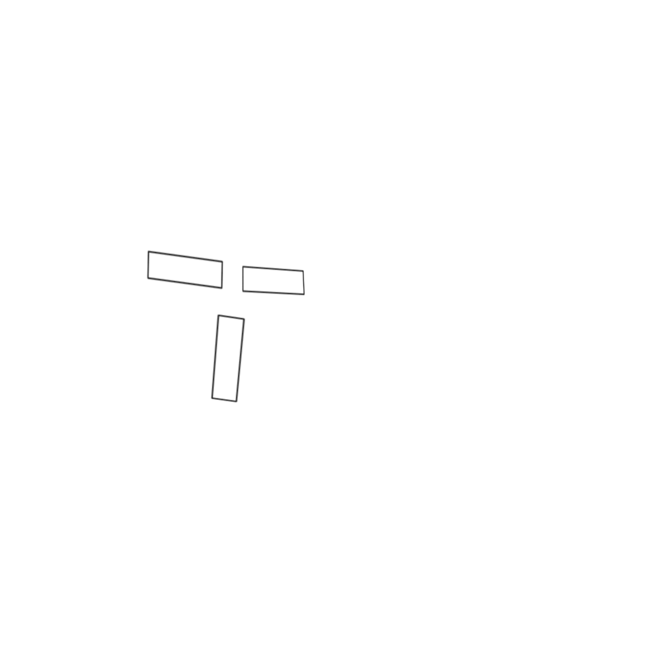

Slide 5



Example :
Payment methods
3rd party items
Etc.

Slide 6
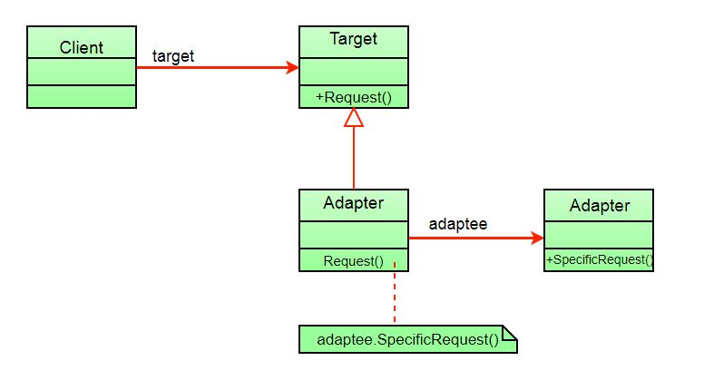
Class Diagram
Source : geeksforgeeks

Slide 7
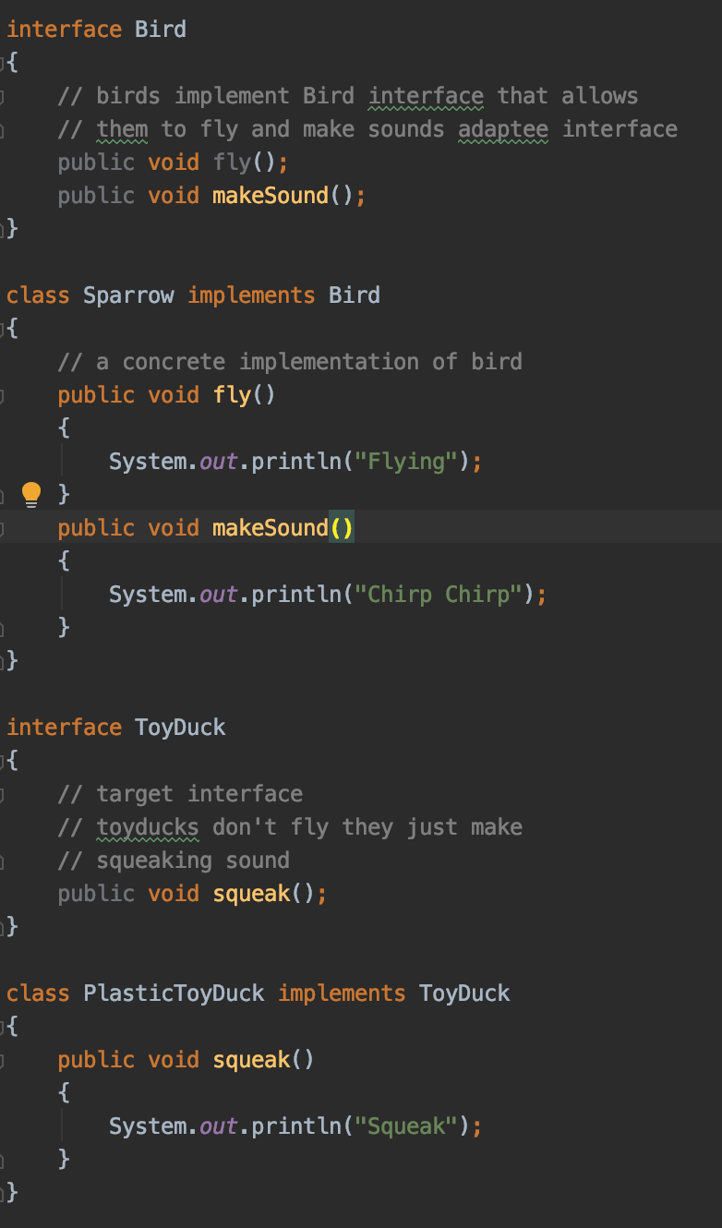
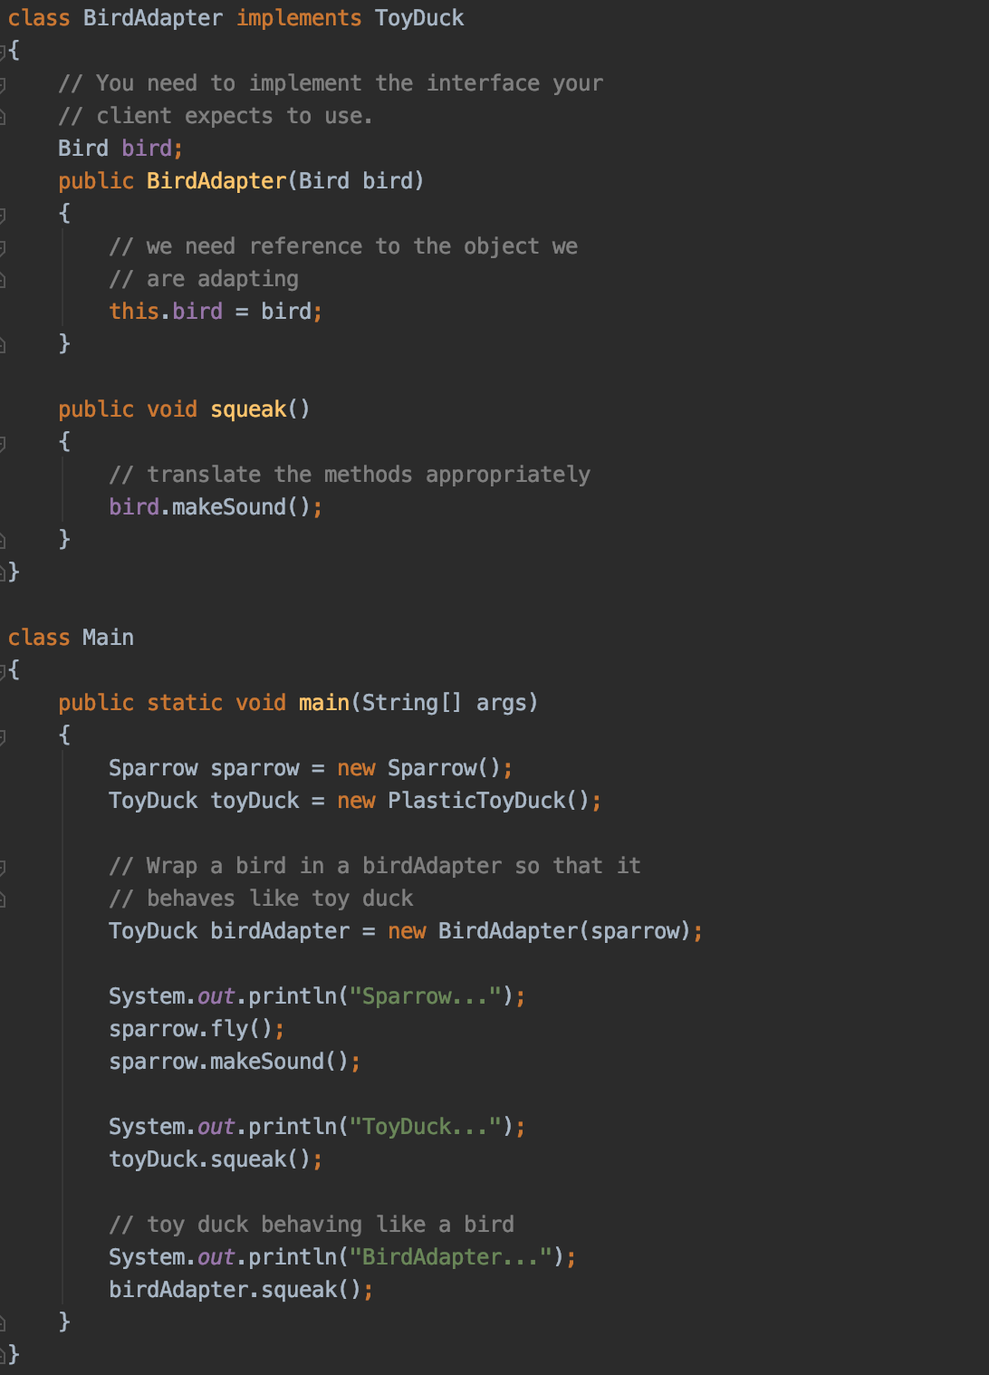


Slide 8
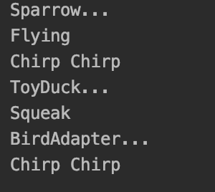

Slide 9
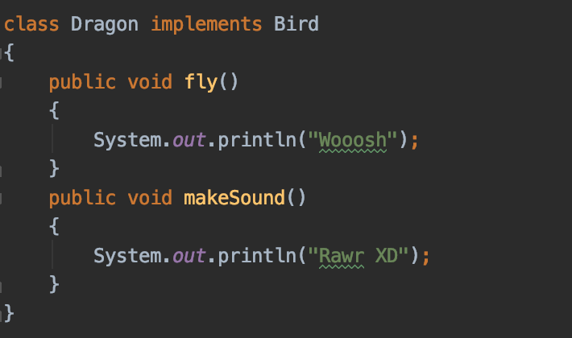

Hey I want a duck that make dragon noises
Main

Slide 10
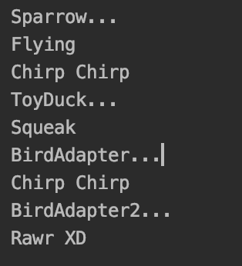

Slide 11
Pros
Cons
You can separate the interface or data conversion from the primary uses of the program
You can add more thing without needing to change or break existing code
The complexity of the code increase because instead of updating the use of what already inside the code you add more interfaces and classes into the program

Slide 12
Thank you.

Slide 13
Source :
https://refactoring.guru/design-patterns/adapter
https://www.geeksforgeeks.org/adapter-pattern/

